Slide 1

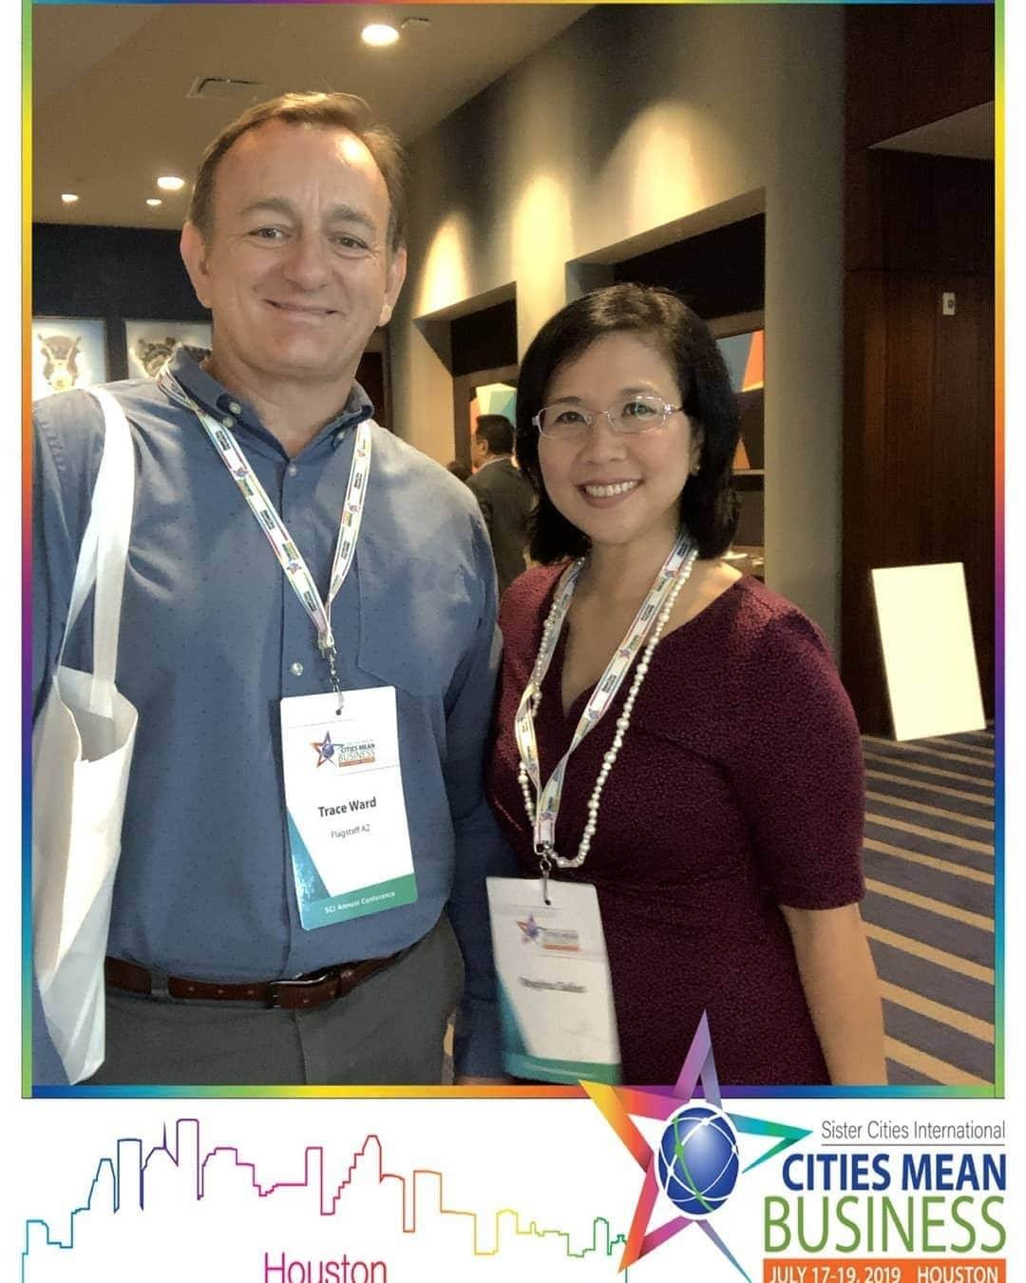
Flagstaff, Arizona
Established 1974-2009 – Re-established 2020
Key Partnerships: City of Flagstaff and Discover Flagstaff (CVB)
Councilwoman Regina Salas and
Discover Flagstaff Director Trace Ward
at the 2019 SCI Annual Conference in
Houston, TX with plans
to re-establish Flagstaff Sister Cities

Slide 2
Flagstaff Sister Cities Leadership
Board of Directors
Key City Officials
Regina Salas – President
Sheila Anders – Vice President
Trace Ward – Treasurer
Cristen Crujido – Secretary
Cesar Flores
Demaris Hill
Lisa White
Councilwoman Khara House – Board Member
Mayor Becky Daggett –
Ex-officio Member

Slide 3
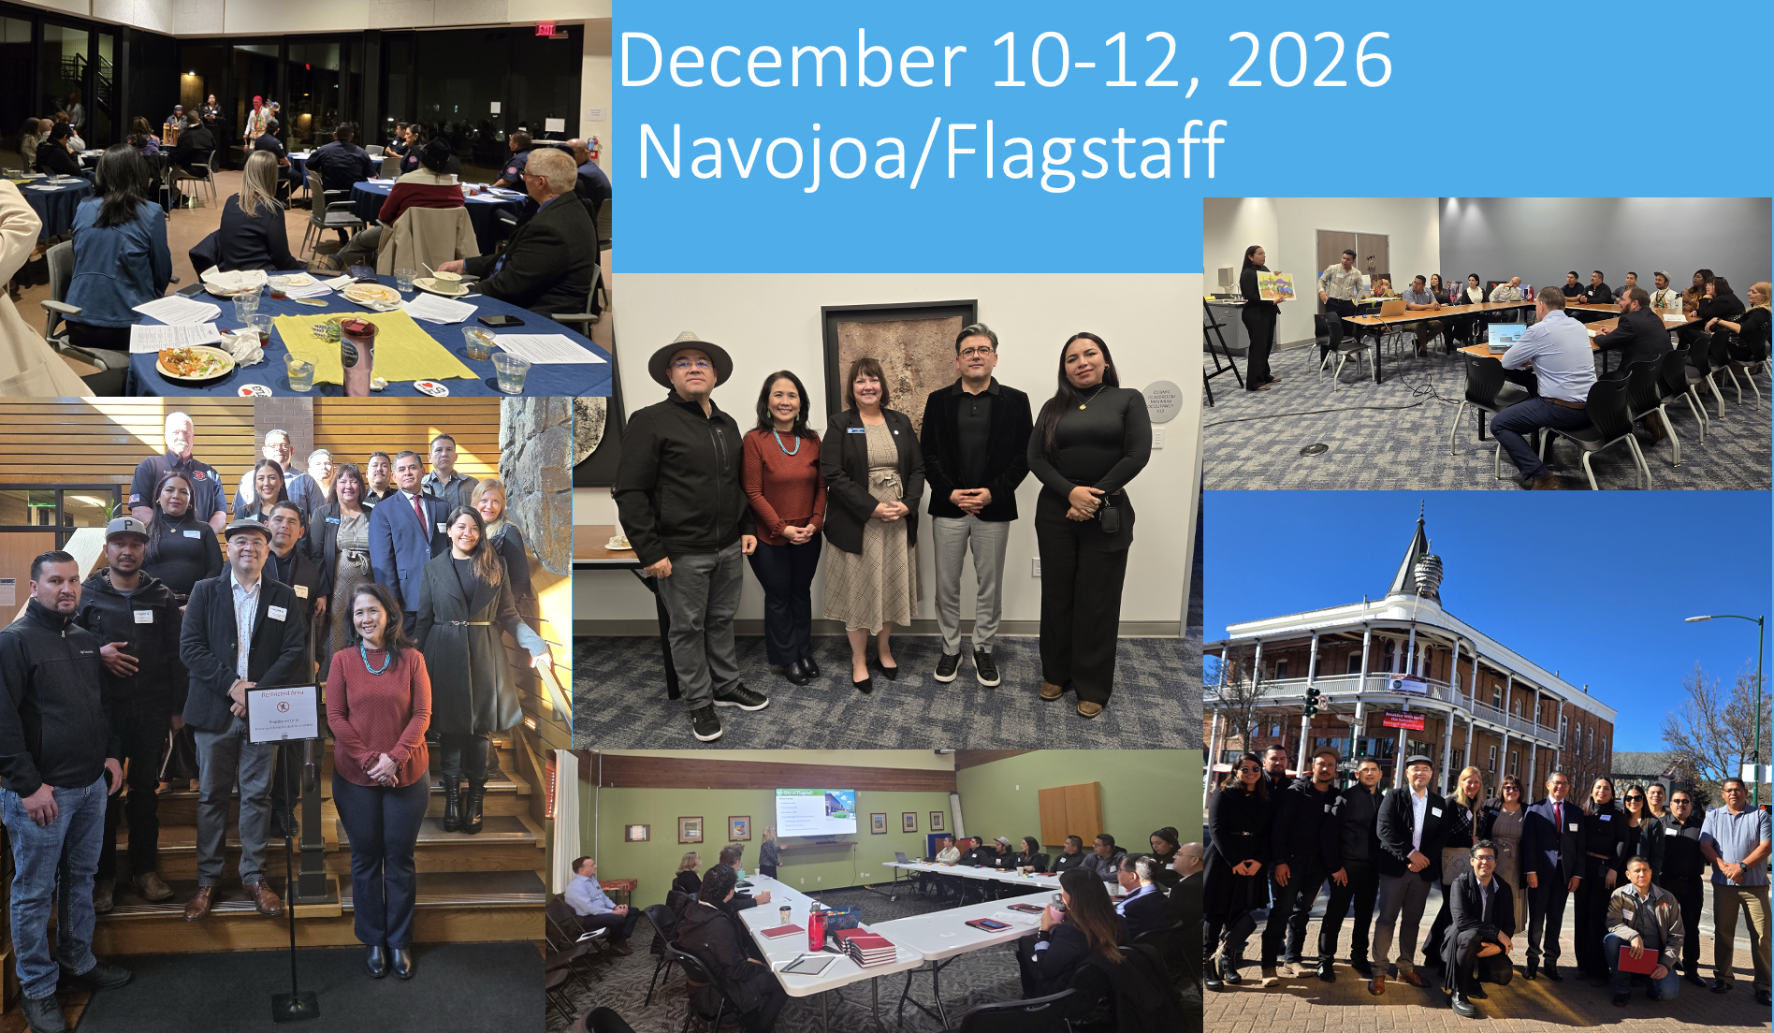
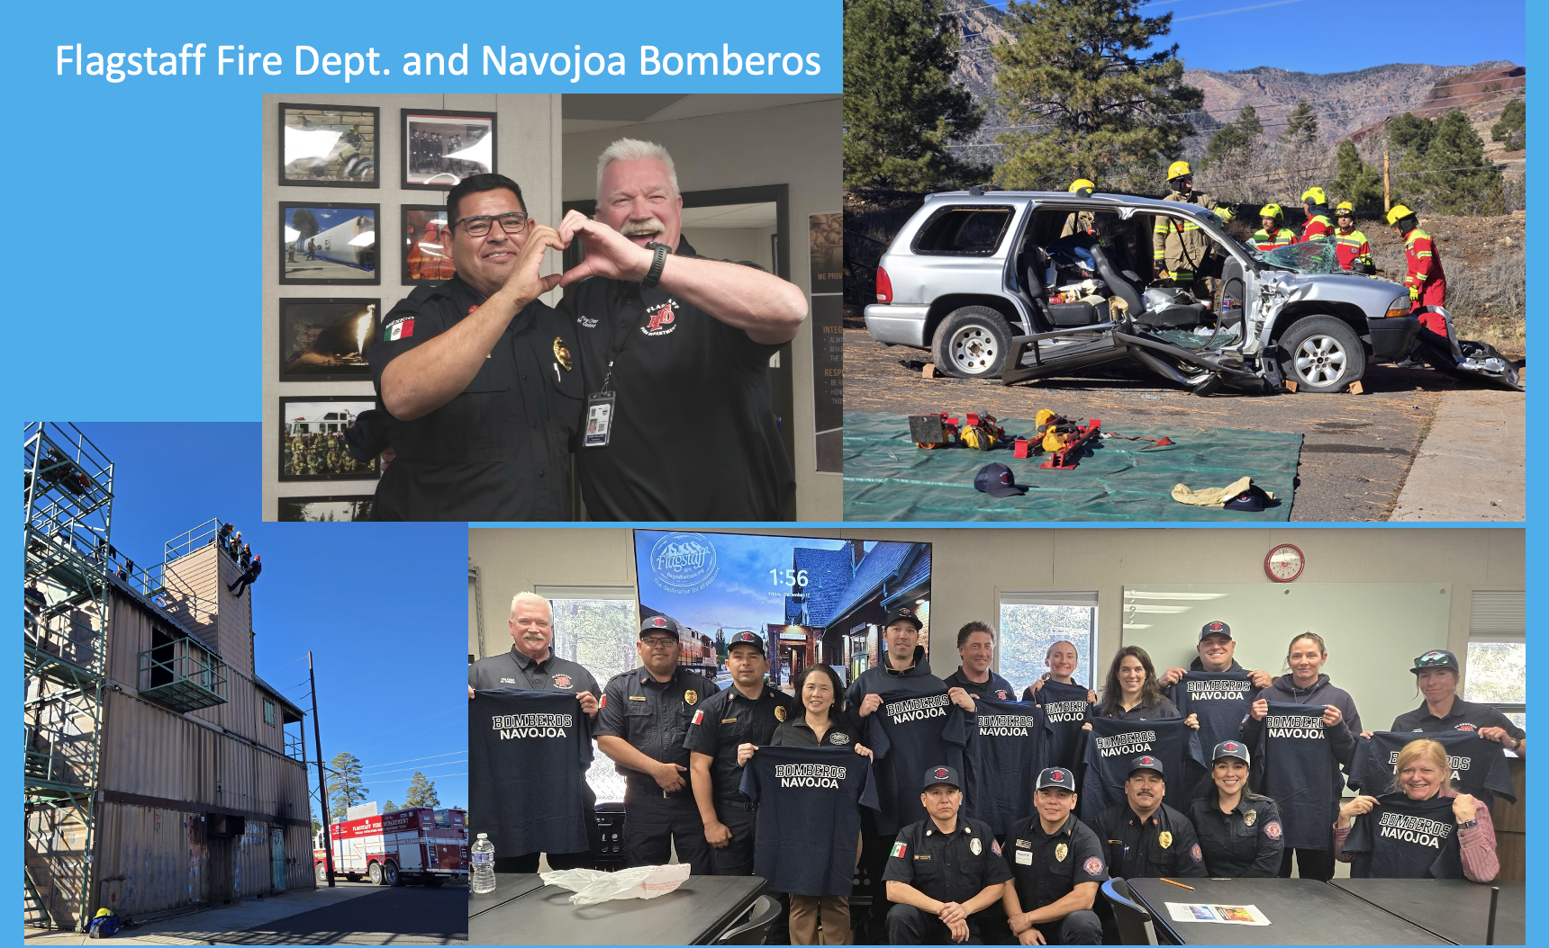
Navojoa, Sonora, Mexico – est. 2023
Delegation Visit and Firefighter Exchange
Official Delegation with Arts and Culture Exchange
Firefighter Exchange
December 2025

Slide 4
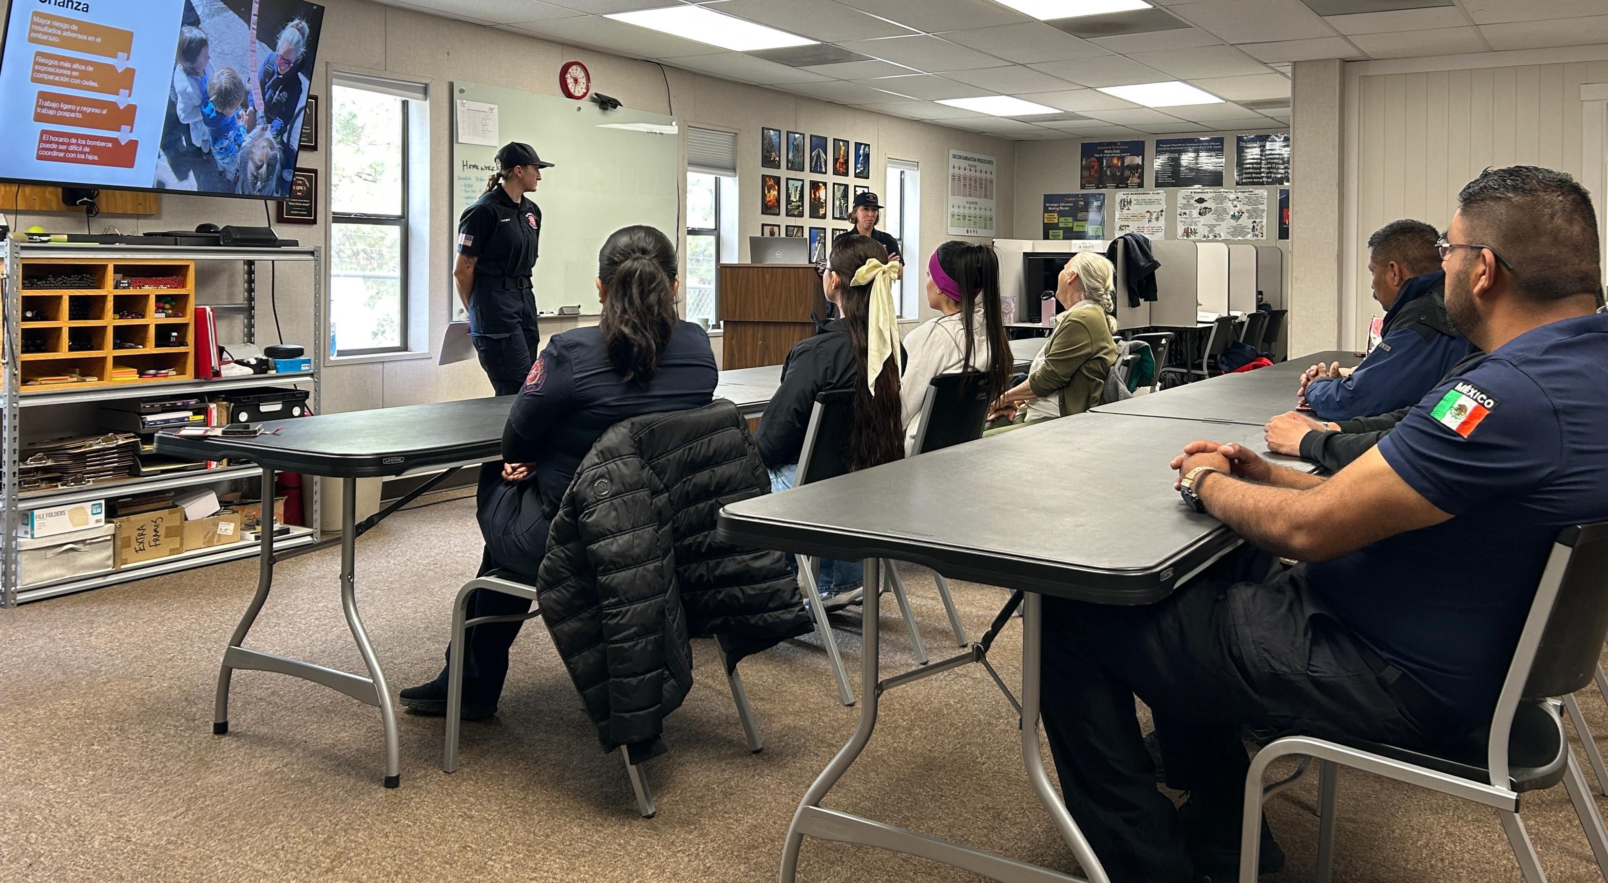
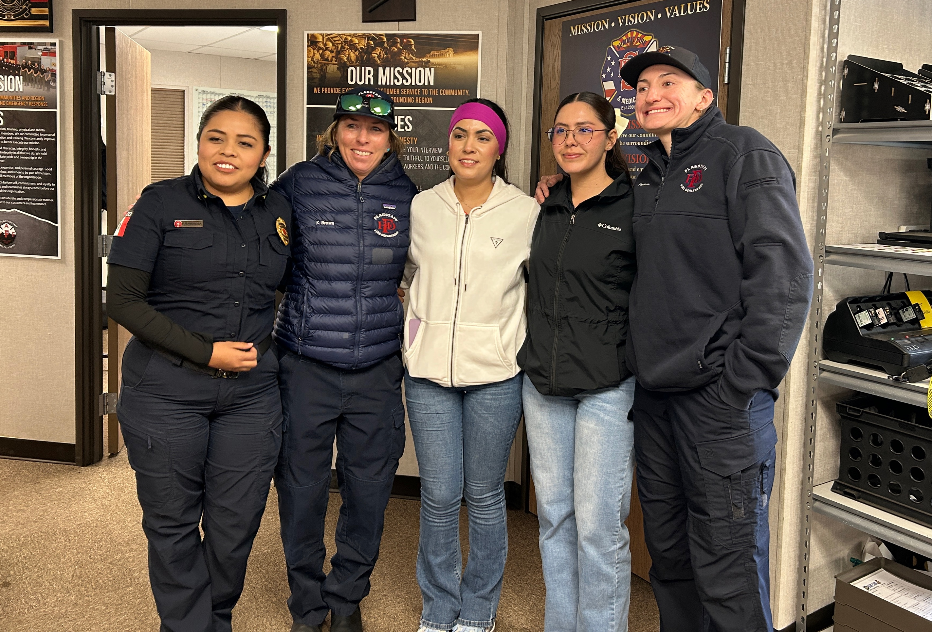
Second Flagstaff Fire Department/Navojoa Fire Department Exchange focusing on issues of Female Firefighters
Presentation by Flag Fire on Women’s Issues (in Spanish)
Female Firefighters from
Navojoa and Alamos, Mexico

Slide 5
Historic Flagstaff Sister Cities
Historical Sister Cities reconnected in 2021
City of Blue Mountains (Katoomba), Australia – est. 1965
Manzanillo, Mexico – est. 1987
Possibly re-establishing
Hsin Tien City, Taiwan – est. 1981

